Slide 1

EDA Case Study
Loan Analysis

Slide 2
In this case our task is to identify the risk of financial loss by the company by not getting repayment of loan and fraud activity. We have analyzed the datasets provided by the company. Finally we have drawn some conclusions and recommendations to minimize the risk of loss.

Slide 3
The overall approach for this analysis is only considering the columns which make sense and dropping every other.

Slide 4
Identifying the missing data and use appropriate method to deal with it.
In our analysis we found that some of the columns have very high numbers of null values and replacing such a high null value is very difficult because we don’t know what could be possible value if missing percentage is very high so we just remove those columns from dataframe.

Slide 5
Since there is not specific approach to replace missing values but most common are
Deleting columns which has large number of missing value.
Replacing by mean value of that variable.
We can use any suitable method to deal with missing values

Slide 6
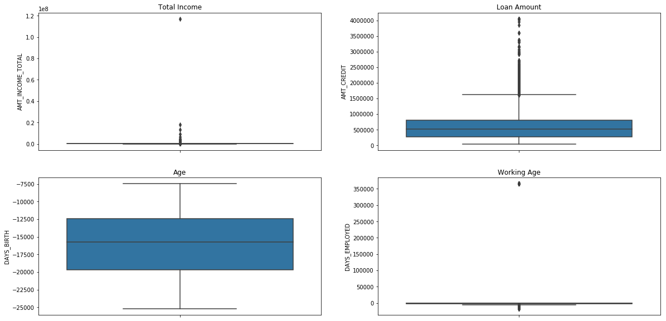
Identifying if there are outliers in the dataset

Slide 7
By looking at the above pictures Total Income, Loan Amount & Working Age has some outlier points because most of the points are in between 25th and & 75th percentile range but in the plots for these three, some points are far from box.

Slide 8
There is data imbalance between Target-1 and Target-0 variable.
The imbalance ratio is 0.09 and percentage is 8.78%.

Slide 9
Univariate Analysis
We found that people are facing more difficulty to repay cash loan than revolving loans for both the targets.

Slide 10
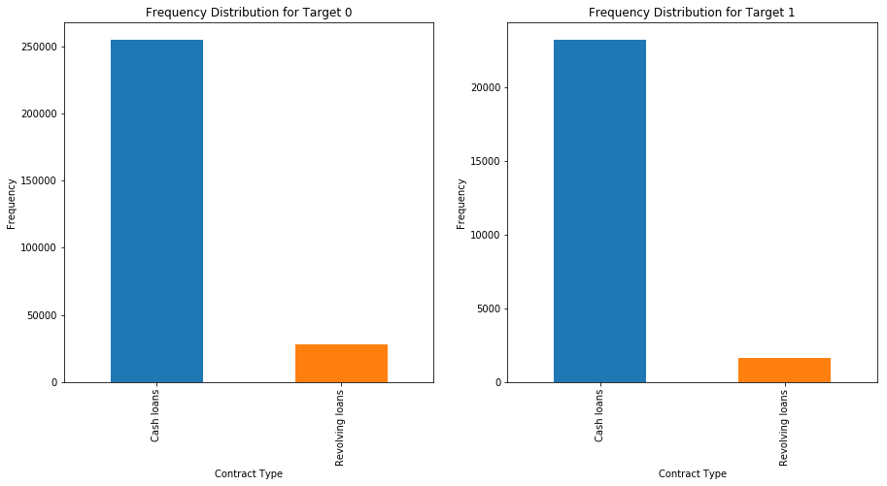

Slide 11
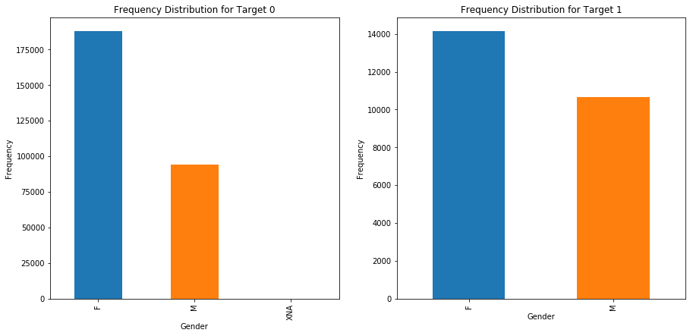

Slide 12
The Second plot shows that females clients pay late more often than male clients.
People who own a car are repaying their loans on time in comparison to those who don’t own car.
Similar with people of reality owner

Slide 13
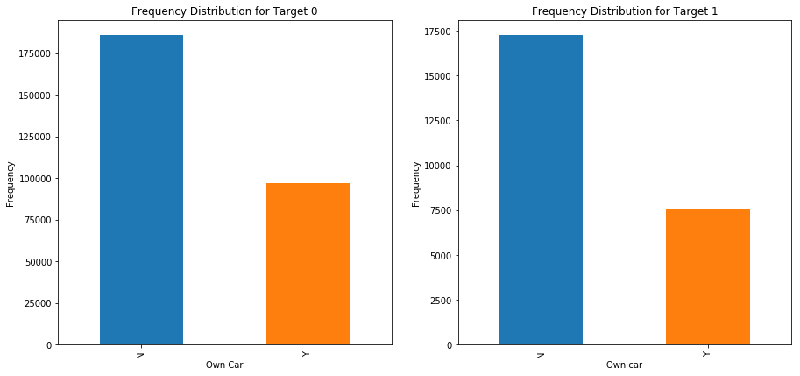

Slide 14
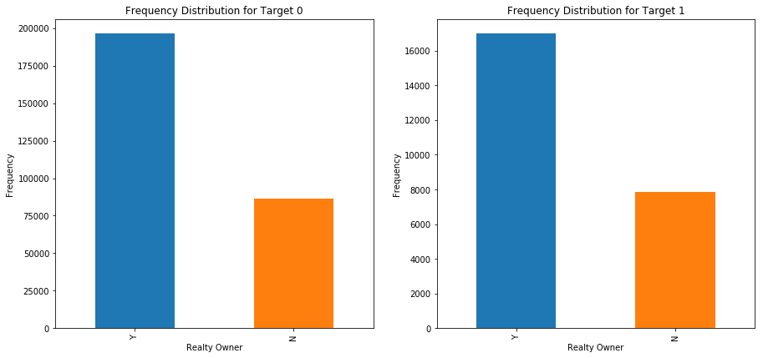

Slide 15
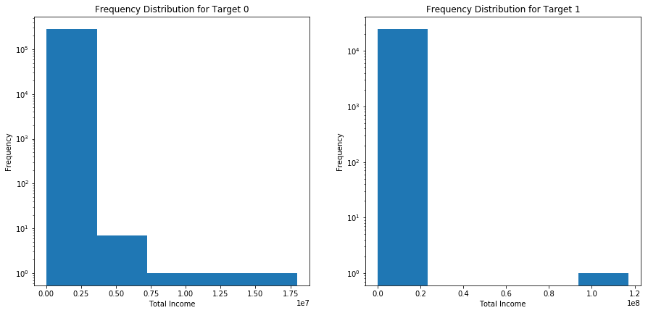
People with low income also found it difficult to repay the loan on time.

Slide 16
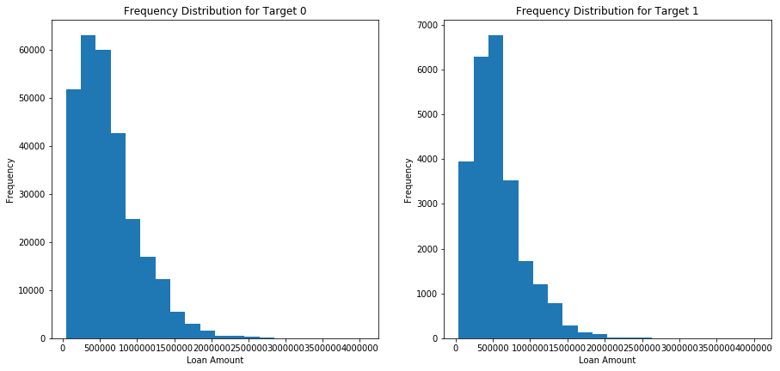
When the loan amount is around 5-7 lacs late payments are more often and it gradually decreases as the loan amount increases.

Slide 17
For Target-1 no. of late payments are less when the loan amount is below 5 lacs.

Slide 18
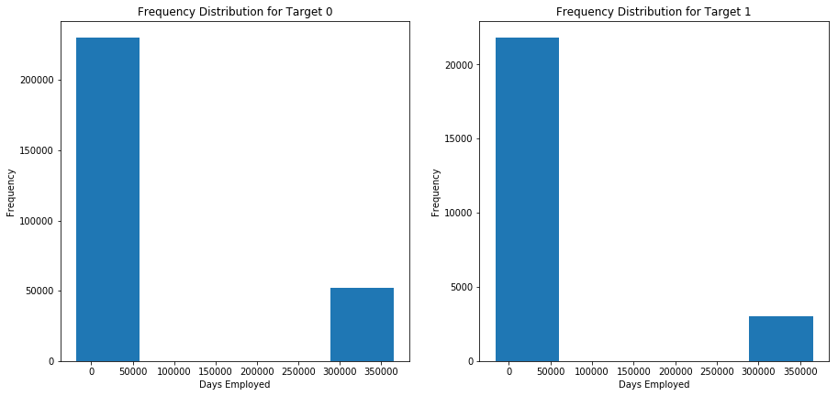
People are taking loan either at the start years of their job or at end years of the job. Also, people who are taking loans at the end of their job are repaying easily.

Slide 19
The top ten correlation between client with payment difficulties and all other cases for the targets are shown in the next plots.

Slide 20
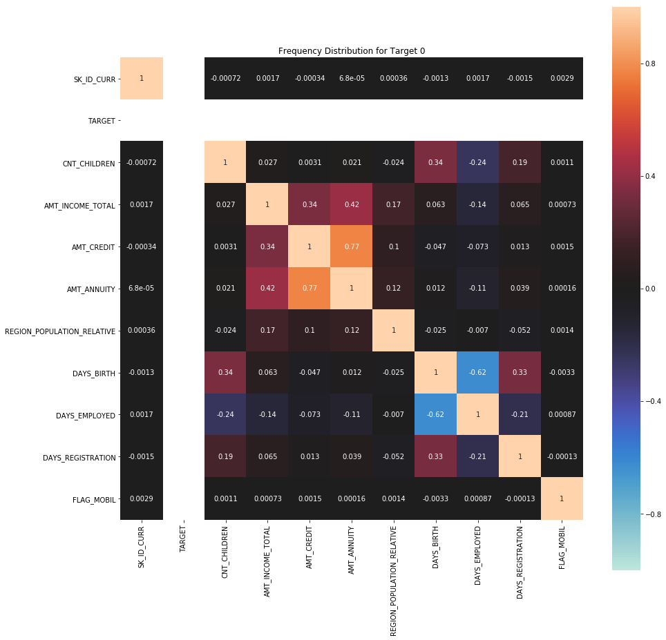

Slide 21
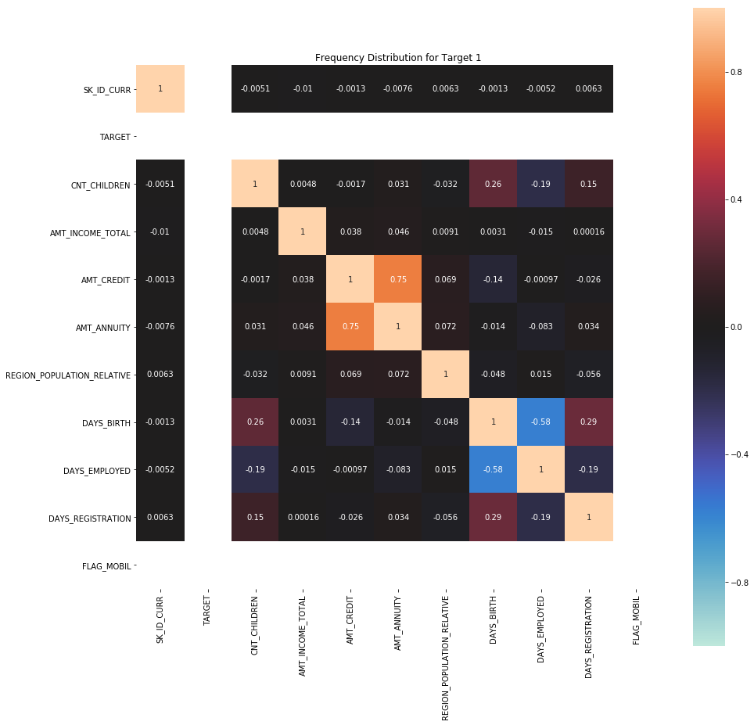

Slide 22
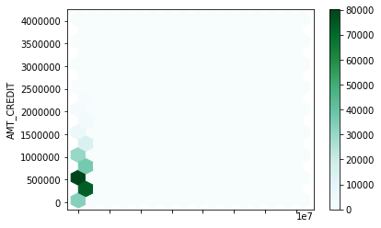
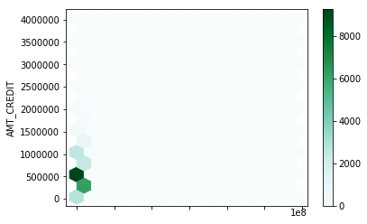
People with low income are late repayors.

